Slide 1
Deep Learning
A Brief Introduction
Kyle Krafka • November 2014

Slide 2
Overview
Machine learning background
  Different types of problems
  Supervised/unsupervised learning
Computer vision 101
Deep learning (limited depth)
Real-world examples
Notes:
Might be better called a machine learning overview
Will go into more detail on Monday

Slide 3
Machine Learning Background
Decades of research packed into a fraction of a class period!
Notes:
Take Dr. Rasheed’s course or Andrew Ng’s online course (Stanford).

Slide 4
Machine Learning
The science of using data to “train” a model
Used to make decisions or predictions
May borrow from:
  Statistics
  Artificial intelligence
  Optimization
  Data mining
  Biologically-inspired models
For example…?
Notes:
Different from the AI search techniques covered in this class.

Slide 5
Linear Regression
I have a dataset of recent house sales in the area
  Square feet
  Price
I want to know how much I should expect sell my house for.
Input: __________
Output: ______
Square feet
Price

Slide 6
Linear Regression
400
300
Price (in $1000s)
200
y = 0.1762x + 18.7532
100
500
1000
1500
2000
Size (in feet²)
Notes:
Input on x, output on y
Plot
Find line of best fit
Model equation
Predict new data based on previously “labeled” data
Could have used a different model, maybe a quadratic

Slide 7
Linear Regression
From a labeled training set, we were able to predict a new data point
One input feature
We learned a linear model with two parameters:
  y = 0.1762x + 18.7532
How does it work?
  What kind of problem is it?
Notes:
Hint: Optimization
Hint: Minimization
Answer: Minimize the error! (What error?)

Slide 8
Minimize the Error
Can represent the error as a function
  Input: _____________
  Output: ______________
Best model uses the parameters that minimize error
model parameters
mean squared error

Slide 9
Plot of Error Function
Notes:
Just a sample.
What are the axes?
Best value is at the minimum.
Optionally open up in MATLAB.

Slide 10
How to find minimum?
Ask Dr. Potter for a good search algorithm
Thankfully, in many cases, we don’t need to worry about multiple local minima
  Error function has a bowl shape
Set derivative equal to zero and solve
  Not always the best option
Gradient descent
  Frequently used in machine learning to minimize error
Notes:
Stop before third bullet point.
What’s the magical calculus tool we can utilize.

Slide 11
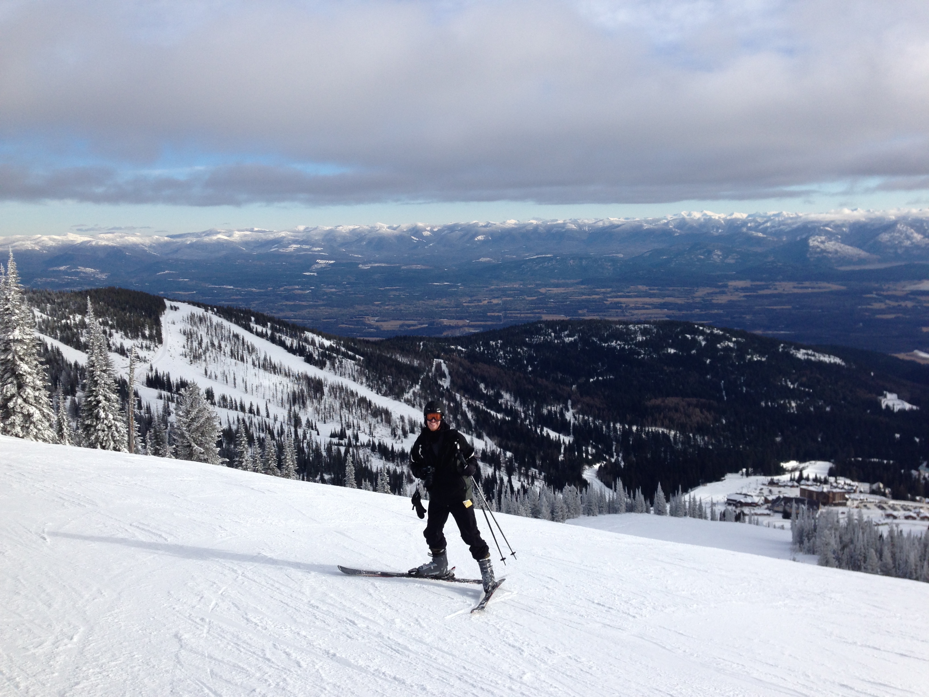
Let’s descend some gradients!

Slide 12
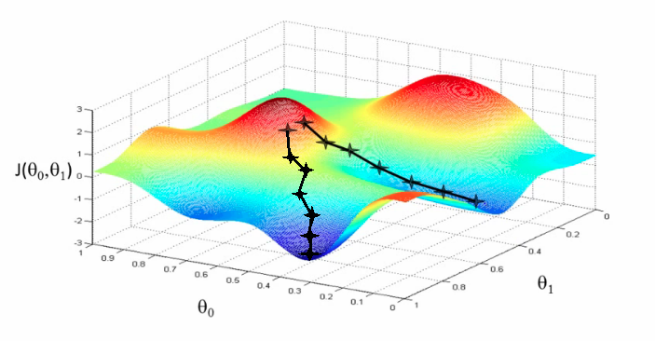
Gradient Descent
Notes:
Why do we need the derivative?
In this example, we have two local minima.

Slide 13
Gradient Descent
Notes:
Same error plot, just contours.

Slide 14
Multiple Features
Multiple input features can make for better predictions
  Higher-dimensional data is harder to visualize
Example:
  x₁ Square feet
  x₂ Number of bedrooms
  x₃ Number of bathrooms
  x₄ Plot size
y = __x₁ + __x₂ + __x₃ + __x₄ + __
Notes:
Hyperplane

Slide 15
Regression vs. Classification
Difference: type of output
Regression predicts a real output value (y∈ℝ) for a given input
  The linear model directly computes new values
Classification predict which class (from a small number of classes) the input belongs to
  The linear model divides classes
Notes:
Terminology

Slide 16
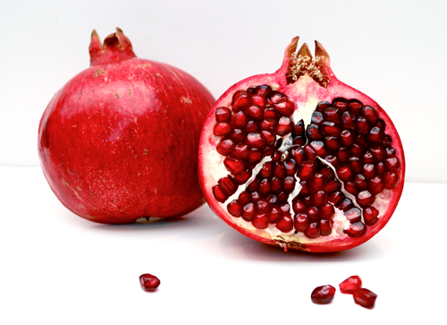
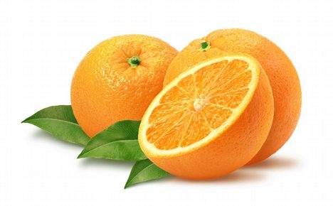
Classification
Pomegranate or Orange?
Notes:
We have a farm and we grow pomegranates and oranges.
(Not likely; opposite seasons.)
We harvest them and throw them into one bin.
We have a scale and a brightness sensor.
How can we separate them automatically?

Slide 17
Classification
Pomegranate or Orange?
Brightness
?
Weight
Notes:
First, we train it by measuring sample fruits.
Find a line, similar to the regression… but different.
We would classify the new fruit as…? (Pomegranate)
How confident are we…? (Very… why?)
Some errors… how can we improve? (Add more features… color?)

Slide 18
Types of Learning
Supervised
  Train on labeled examples
Semi-supervised
  Train on unlabeled examples from the same distribution as what you will be classifying
Unsupervised (a.k.a. self-taught)
  Train on unlabeled examples from a different distribution as what you will be classifying

Slide 19
Supervised Learning
For example, the fruit example…
  We had lots of labeled examples
What about the houses example?
Easy to get good results; used frequently
  Spam classification
  Tumor classification (malignant or benign)
Not always practical… why?

Slide 20
Semi-Supervised Learning
Unlabeled examples, same distribution
Brightness
Weight
Notes:
Find the line that has the most separation
Still need one from each group
Practical!

Slide 21
Unsupervised Learning
Unlabeled examples, different distribution
Is unsupervised learning useful at all?
Brightness
Weight
Notes:
Want to classify pomegranates and oranges
Training on all kinds of fruits… maybe even a basketball and a rock
Apple
Cantaloupe
Grapefruits
Useful at all? NO! Not for this problem.

Slide 22
Unsupervised Learning
Used in deep learning (more later)
Practical use for clustering problems
Any real-world examples?

Slide 23
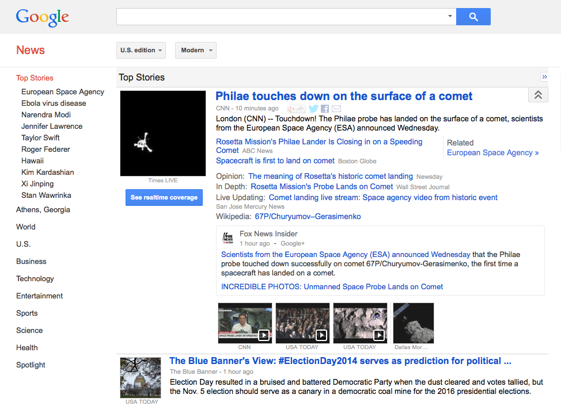
Notes:
Automatically clusters news articles by topic

Slide 24
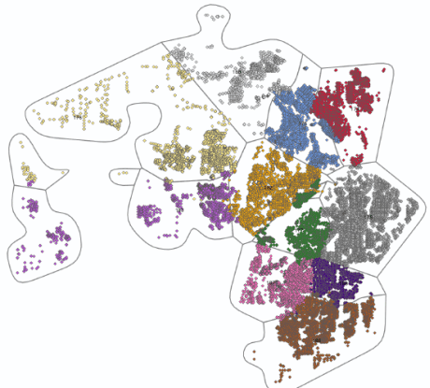
Clustering Customers
Choose different marketing campaigns
for different groups of customers.
Notes:
Say that three times fast!

Slide 25
Congratulations!
You now know machine learning!

Slide 26
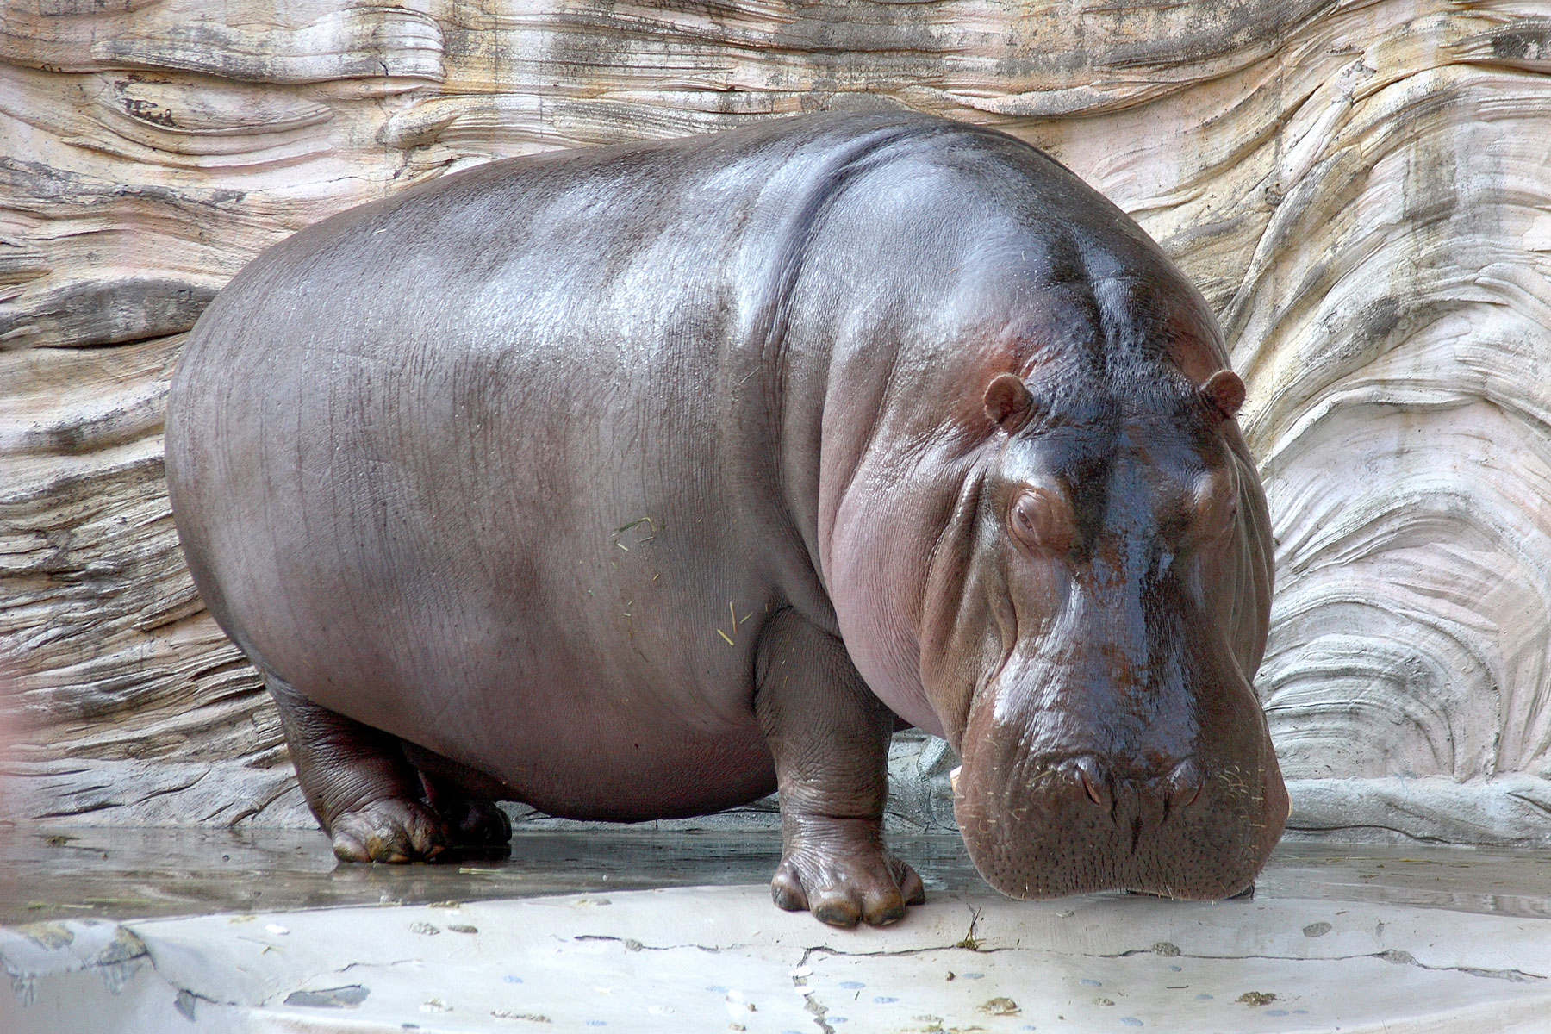
Notes:
Rando hippo! Stretch break.

Slide 27
Review
Regression and classification problems
Linear models
Supervised, semi-supervised, and unsupervised

Slide 28
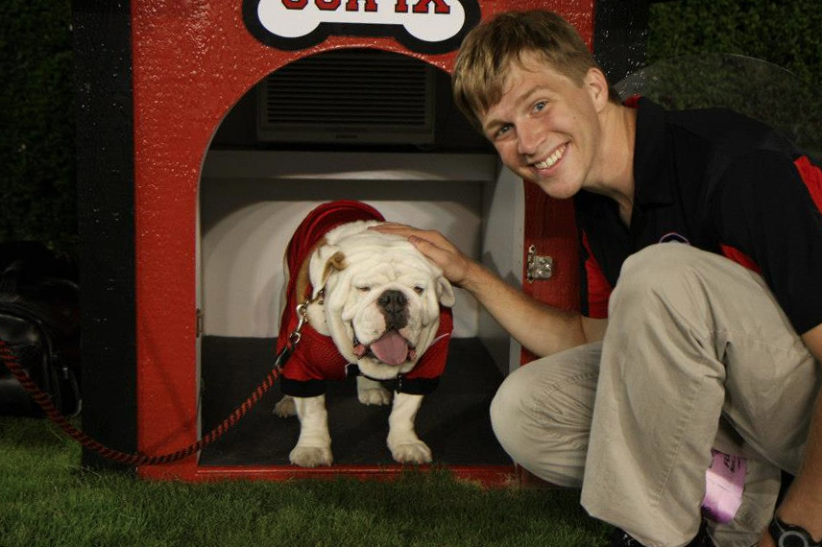

Computer Vision
Field of study that tries to make sense out of visual input
  Interpret images/video like humans do
  Many hard problems rely on machine learning
Example problem from computer vision: face detection

Slide 29

Computer Vision
Another example: Classify an image as either a winter or a summer scene
  Train a classifier with many examples of winter and summer images
  What would the features (real numbered inputs) be?
Sample Winter Image

Slide 30
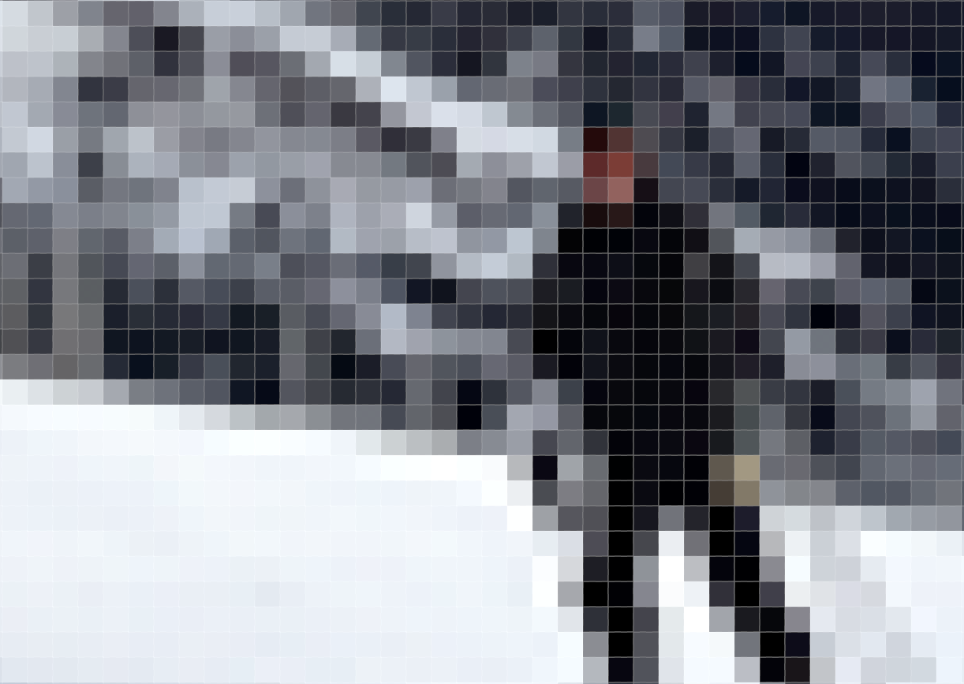

Slide 31
235 | 232 | 250 | 205 | 23 | 1 | 125 | 255 | 174 | 6 | 0 | 119 | 245 | 196 | 196 | 225 | 241 | 237 | 238 | 241
234 | 229 | 253 | 150 | 0 | 2 | 114 | 250 | 234 | 37 | 0 | 49 | 232 | 217 | 210 | 205 | 241 | 234 | 234 | 235
236 | 235 | 241 | 218 | 35 | 0 | 52 | 224 | 255 | 145 | 20 | 8 | 116 | 223 | 207 | 210 | 221 | 239 | 232 | 232
233 | 235 | 232 | 245 | 120 | 0 | 64 | 221 | 246 | 243 | 95 | 0 | 12 | 188 | 211 | 220 | 198 | 224 | 231 | 230
230 | 231 | 237 | 243 | 165 | 8 | 64 | 217 | 243 | 243 | 173 | 5 | 19 | 182 | 225 | 198 | 197 | 201 | 233 | 225
238 | 241 | 239 | 217 | 149 | 31 | 58 | 202 | 242 | 233 | 237 | 124 | 48 | 173 | 230 | 187 | 228 | 226 | 229 | 230
210 | 173 | 104 | 63 | 51 | 45 | 64 | 160 | 229 | 240 | 250 | 204 | 63 | 131 | 238 | 239 | 228 | 229 | 226 | 227
111 | 77 | 40 | 53 | 64 | 53 | 48 | 65 | 173 | 207 | 216 | 202 | 89 | 97 | 214 | 206 | 230 | 229 | 226 | 223
169 | 172 | 176 | 170 | 166 | 153 | 149 | 136 | 153 | 165 | 176 | 150 | 83 | 82 | 124 | 193 | 233 | 228 | 228 | 227
221 | 219 | 217 | 211 | 211 | 209 | 201 | 182 | 162 | 152 | 164 | 177 | 108 | 57 | 146 | 219 | 230 | 232 | 229 | 232
221 | 222 | 221 | 221 | 218 | 216 | 216 | 214 | 200 | 171 | 147 | 138 | 105 | 122 | 225 | 234 | 236 | 229 | 226 | 230
224 | 222 | 223 | 222 | 223 | 223 | 222 | 221 | 225 | 221 | 210 | 143 | 109 | 207 | 236 | 225 | 222 | 222 | 224 | 224
226 | 224 | 225 | 224 | 223 | 226 | 223 | 220 | 224 | 226 | 194 | 145 | 165 | 225 | 227 | 226 | 226 | 221 | 217 | 215
Notes:
Simplification, because B&W.
This is the kind of data where deep learning shines.

Slide 32
Feature Extraction
Problem: Raw images are too high-dimensional and granular for machine learning algorithms to work well!
Solution: Pre-process the image to get higher-level information out of it
  We call this feature extraction
100×100×3
Notes:
Tiny image has 30,000 features.
Would try to assign a weight to each pixel.
Might hear “30,000-dimensional feature vector.”

Slide 33
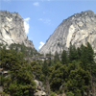
Feature Extraction
Global
  E.g., average pixel brightness
Binned
  E.g., percentage of blue pixels for each of four image quadrants
Local
  E.g., edge map
Any ideas for a good feature for classifying winter and summer images?
Notes:
Satisfactory answer: percentage of green pixels in lower third, and/or percentage of white pixels in lower third.
Draw classification on the board.

Slide 34
Feature Extraction
Decades of effort have gone into hand-crafting descriptive features
  Simple and complex options
  Still the go-to technique of computer vision researchers
There are limitations
  Hard to improve upon
  Hand-crafted features are inherently limited
  It doesn’t use AI!

Slide 35
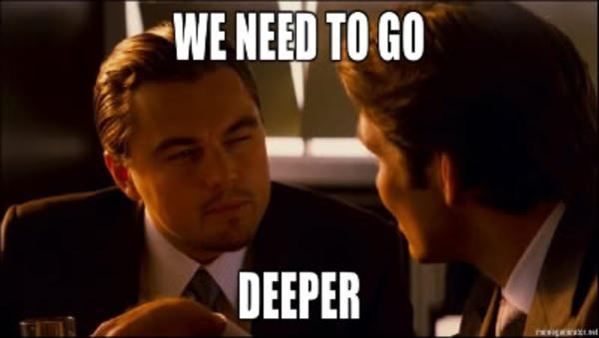

Slide 36

Why not just learn the features, too?

Slide 37
Learning Features
What type of learning would it be?
  Supervised?
  Semi-supervised?
  Unsupervised?
We don’t know what we’re looking for!
  Cluster together similar image parts and represent images in a “paint by number” manner
  Might even use images from all over the internet!

Slide 38
Deep learning is…
Set of algorithms in machine learning
Utilize a hierarchical structure to go from low-level data to high-level abstractions
A hip buzzword for a particular breed of neural networks and related strategies

Slide 39
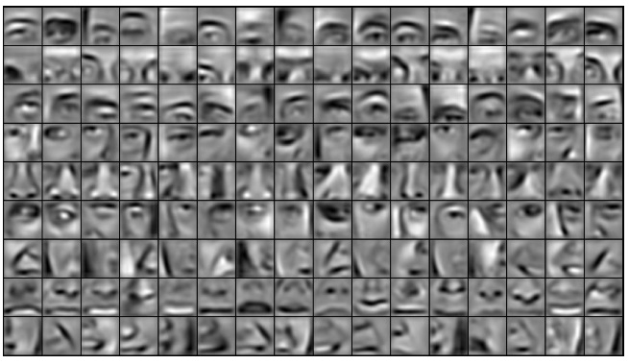
Learned!
174 | 174 | 175 | 173 | 164 | 145 | 138 | 132 | 125 | 129 | 136
174 | 169 | 160 | 153 | 145 | 124 | 121 | 136 | 143 | 157 | 172
164 | 151 | 144 | 128 | 119 | 126 | 132 | 152 | 177 | 167 | 146
148 | 132 | 121 | 112 | 119 | 146 | 154 | 137 | 121 | 106 | 84
137 | 120 | 105 | 128 | 145 | 138 | 123 | 97 | 66 | 63 | 47
120 | 109 | 121 | 138 | 129 | 91 | 67 | 58 | 53 | 61 | 68
112 | 114 | 129 | 105 | 92 | 84 | 68 | 61 | 78 | 103 | 131
116 | 130 | 116 | 82 | 106 | 119 | 73 | 66 | 91 | 92 | 90
1
Low-level
Raw pixels
Mid-level
Distinguishing features
2
Deep Learning Architecture
For Computer Vision Applications
Learned!
It’s a face!
3
High-level
Semantic label

Slide 40
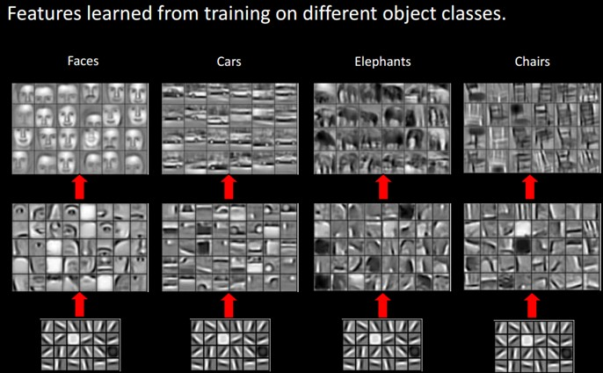

Slide 41
Biologically Inspired
The brain is believed to work in a similar manner: different layers devoted to different tasks
  V1 region works as an edge detector
We experience a lot of unlabeled data that helps shape our world view
We will use a biologically inspired model

Slide 42
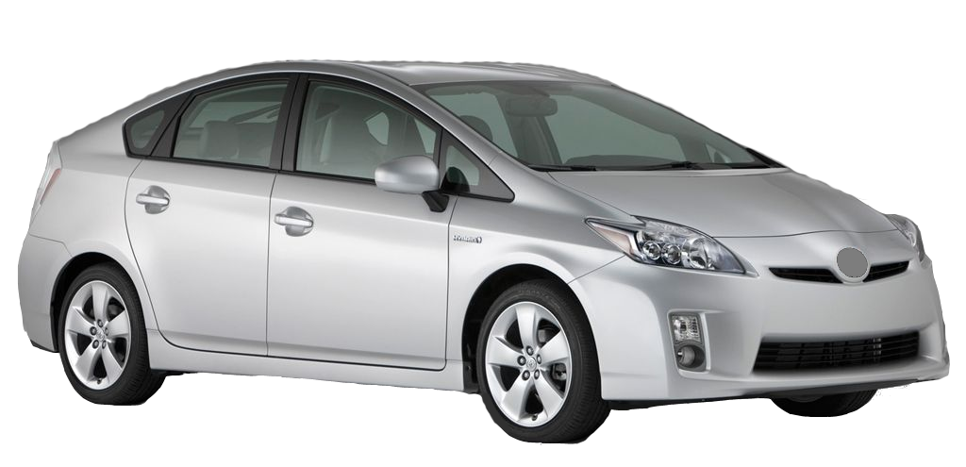
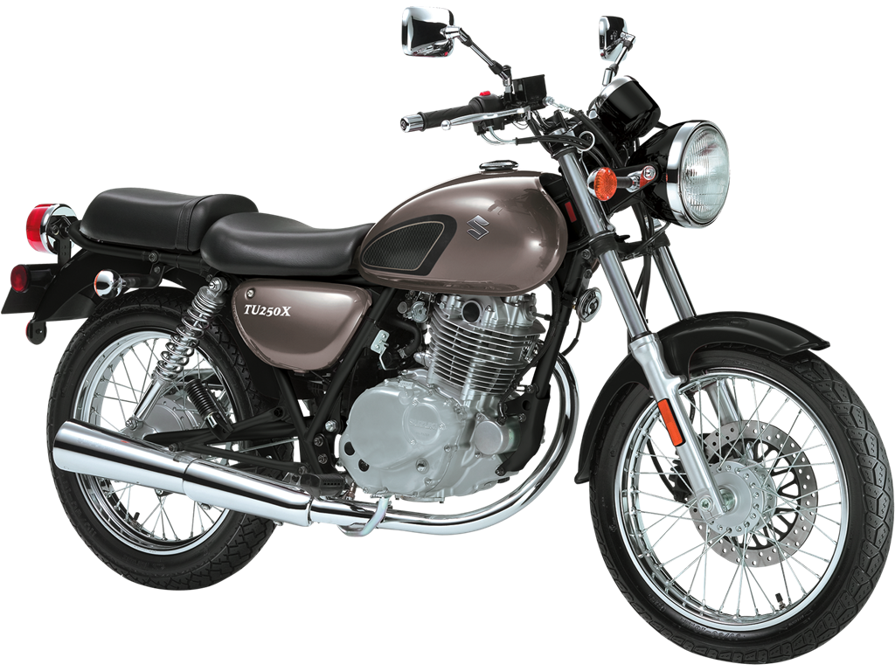
Example
Problem: We want to classify images as either car or motorcycle.

Slide 43

Learn features
  Given many unlabeled image patches, learn k distinct “bases” (unsupervised)
  May do this at multiple levels
Extract features from training images
  Represent the images using only the learned bases
Train in a usual supervised (or semi-supervised) manner
  E.g., “This particular combination of bases is a motorcycle.”
Evaluate new images the same way
Notes:
.5 Base #3
.8 Base #20
.1 Base #14

Slide 44
Deep Learning
Conceptual Questions
Why do we need the middle level?
How does this differ from traditional techniques?
Notes:
Don’t answer these yet.

Slide 45
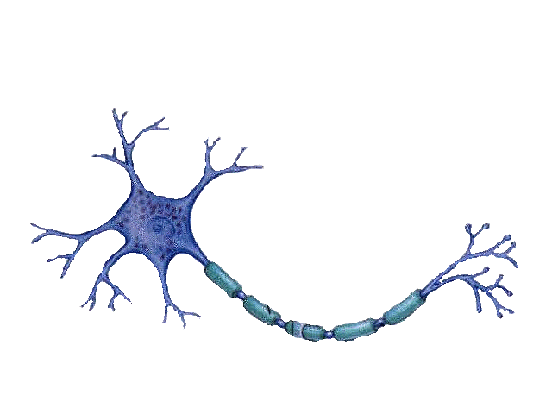
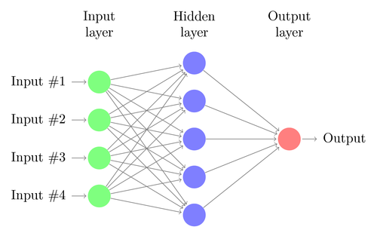
Implementation
Neural networks
  Loosely modeled after the brain
  Each node is like a neuron
  Each node has:
    Inputs
    A learned weight for each input
    An output processed by an “activation function”
Notes:
Normal neural network

Slide 46
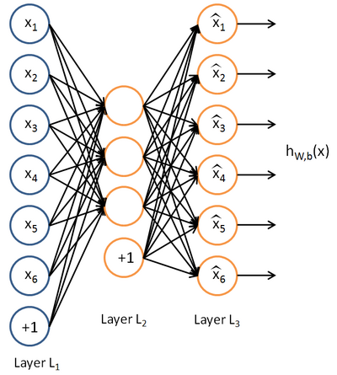
Implementation
Sparse Autoencoder
Notes:
Input and output are the same; the model must learn how to reproduce the input using the limited number of nodes in the hidden layer.
After training, take off the last layer.
More details in a later class.

Slide 47
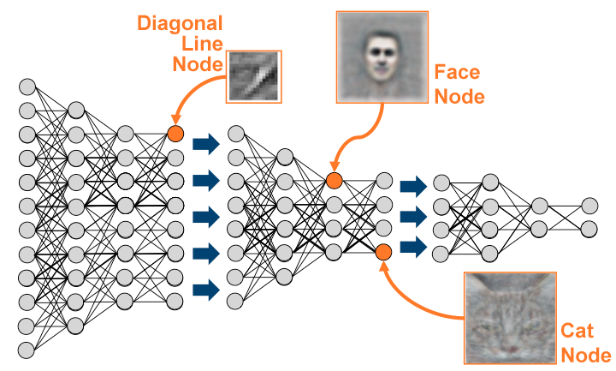
Trained Deep Learning Neural Network

Slide 48
Results
It actually works!
Takes some tweaking to outperform existing hand-crafted methods
This one technology that has “knocked over” benchmarks in a wide variety of fields
  Why?
Good performance requires
  Lots of data
  Large models
Notes:
It’s not hand-crafted! It scales.

Slide 49
Applications

Slide 50
Google Brain
Developed initially by Andrew Ng
In June 2012:
  16,000 machines
  10M digital images from YouTube videos
  Able to recognize cats very well
Used in various technologies
Notes:
Computer vision: Google “my pictures of mountains,” and “my pictures of beaches”
Speech recognition: Google Now, fast and slow versions as words light up
Microsoft Adam

Slide 51
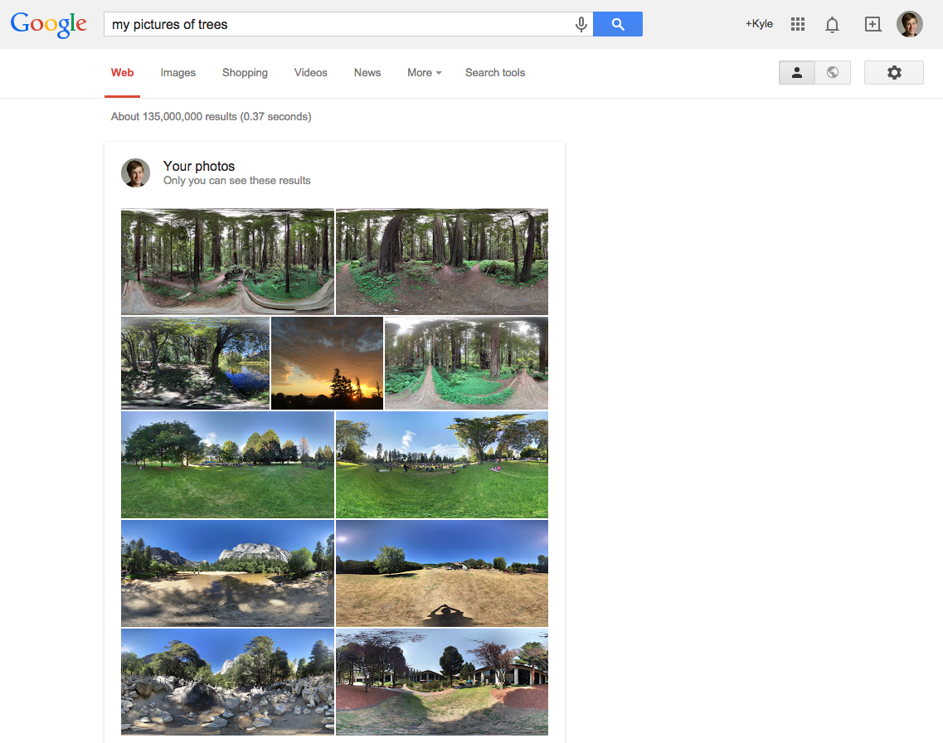

Slide 52
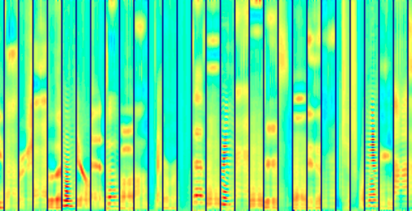
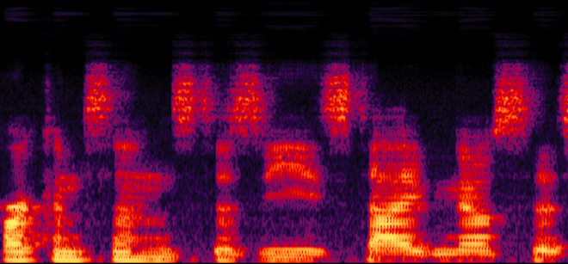
Speech Recognition
Learn bases from the spectral graph
Learn higher-level representations of speech using the bases

Slide 53
Thank you!

